Slide 1
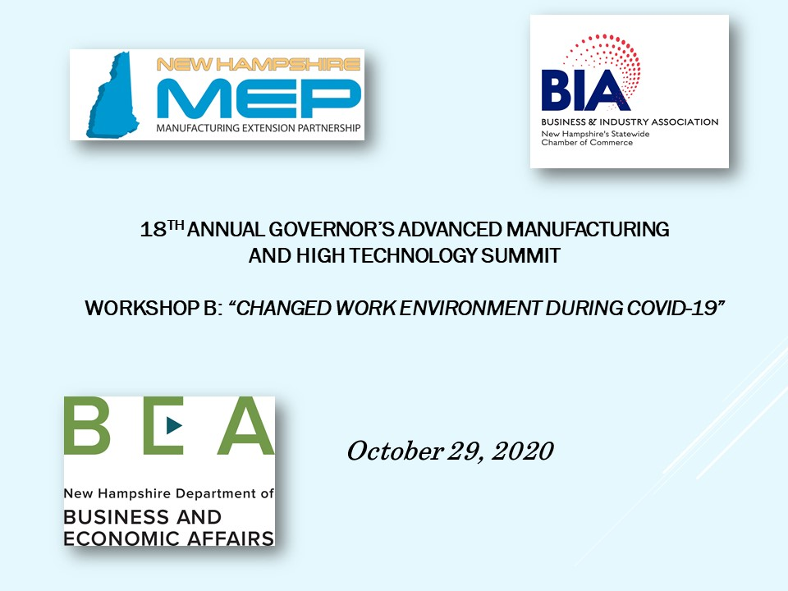

Slide 2
Changed Work Environment During Covid-19 Jewell Instruments’ Journey (so far)
18th Annual NH governor’s manufacturing summit
October 29, 2020

Slide 3
Background
105 employees in Manchester, NH where we design and manufacture avionics mechanisms and precision sensors
– our business is considered an “essential business” in the US
– our export revenues are > 50% of sales
66 employees in Barbados where we manufacture analog and digital meters and solenoids
– no businesses in Barbados were considered “essential”; our operation was shut down for 7 weeks and all employees were confined to their homes for the first month

Slide 4
First Steps
Educate
Educate ourselves in CDC guidelines and State of NH guidelines for safety and allowable operations
Determine and enact
Determine and enact appropriate facility health and safety guidelines, extra cleaning regimen, acquisition of PPE for personnel that would remain on site, daily health monitoring questions and temperature required prior to entering the facility
Establish
Establish Visitor and Travel Policies – No Visitors, No Company travel

Slide 5
Identify those personnel who were able to work remotely and equip those who did not already have proper computer equipment – to support business systems and Jewell cybersecurity requirements
- Front Office staff
- All Sales & Marketing staff
- Design Engineering staff worked fully remote for the first month, then transitioned to every other day remote until September
- Supply Chain staff have alternated every other day in the office

Slide 6
All Line Supervisors, Manufacturing Engineering, Warehouse and Shipping staff and all Production staff have worked throughout the Pandemic on-site in Manchester on two shifts
We immediately staggered the lunch break to allow for better social distancing in our cafeteria
We allowed some 1st shift employees who wanted to stagger with 2nd shift to accommodate temporary changes in childcare and family work schedules
Most workstations were already spaced more than 6’ apart but we made slight alterations in a few Cells for better social distancing
During the first few weeks we furloughed 6-8 employees who worked in Cells that had material shortages due to COVID-affected suppliers; we have also had two employees who have remained out for the duration because they have medical conditions that put them at risk of contracting COVID – Jewell has had no infections within our Company

Slide 7
What has this meant for new business?
Although we cancelled several international trade events, we had a strong export sales channel in place prior to COVID-19 so we have been able to maintain good communication with our distributors and customers
New orders since this Spring have ebbed and flowed as regions have been affected globally but we are within 15% of our YTD target
Business from new customers is off
We have suffered from some supply chain disruption due to COVID-19, however, this has mainly affected our “non-essential” business where several customers have been shut down thus minimizing the impact of shipment delays

Slide 8
Business and Social Impacts from operating during COVID-19
We have been forced to use an existing video-conferencing tool that was little used before – both for internal meetings where we still shy away from using conference rooms and for customer and supplier communication - I believe this “habit” will remain even after we can safely fly again
During a strange labor market, we have had some turn-over yet we have also hired some very strong new employees
Our ability to pay everyone throughout the Pandemic and provide clear communication at each step that we have taken has been appreciated by staff

