Slide 1
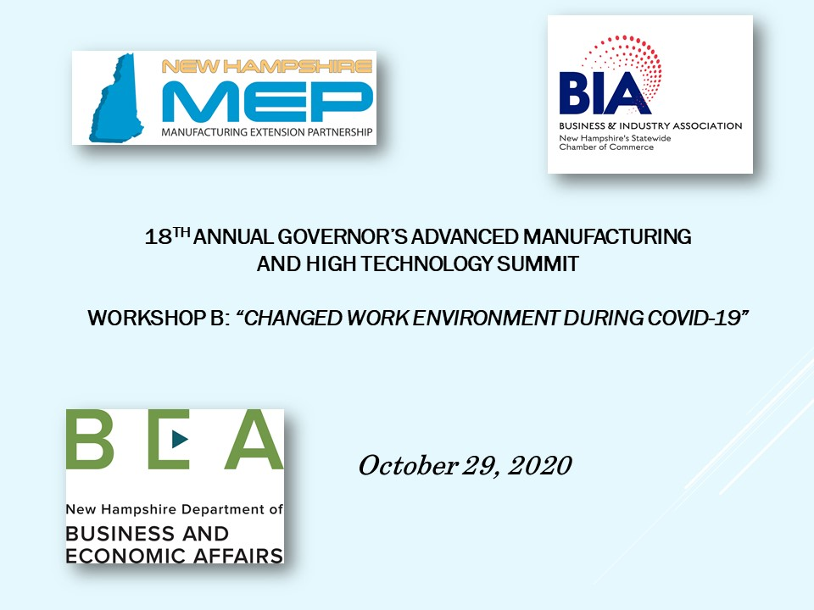

Slide 2
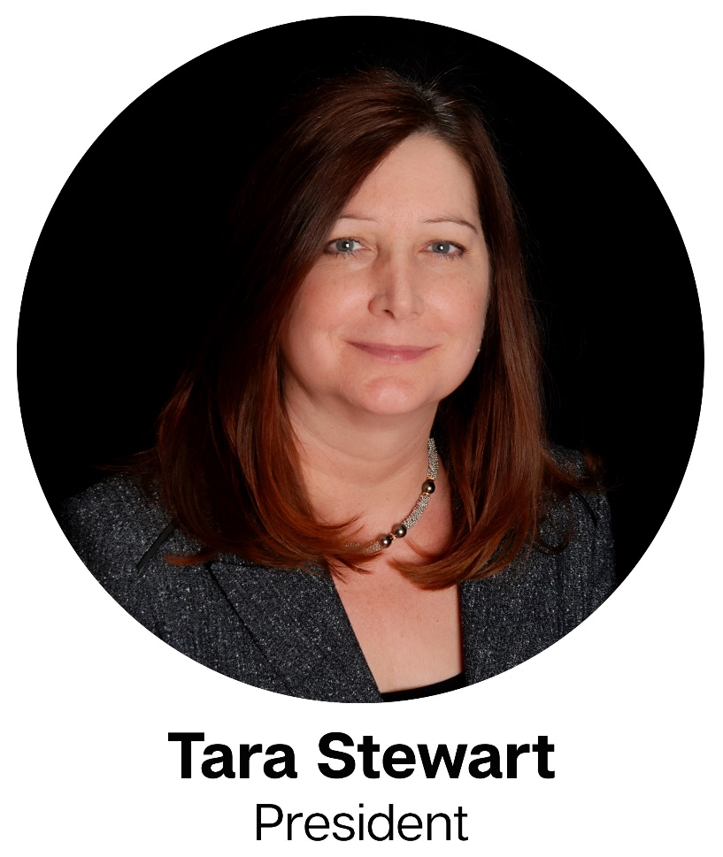
Our Changed Work Environment: COVID-19
We believe technology improves navigation™

Slide 3
Background: Sealite USA, LLC
Government designated small business
Manufacturing/sales offices: Tilton, NH; Cartegena, CO, SA
3 Brands:
Sealite: Marine Aids to Navigation
Avlite: Aviation Aids to Navigation
Star2M: Cloud-based asset monitoring service
# of Employees:
March 28 Employees
October 34 Employees, open positions
Designated “Essential Business”

Slide 4
Mitigation and Control
Data Driven Risk Identification
Proactive Response
Short & Long Term
Change:
Follow:
Guidelines from
CDC
State of NH
Respond:
Remote teams
Cleaning/disinfect
Building restriction
Production/office areas
Travel/events
Employee screening
Contact tracing

Slide 5
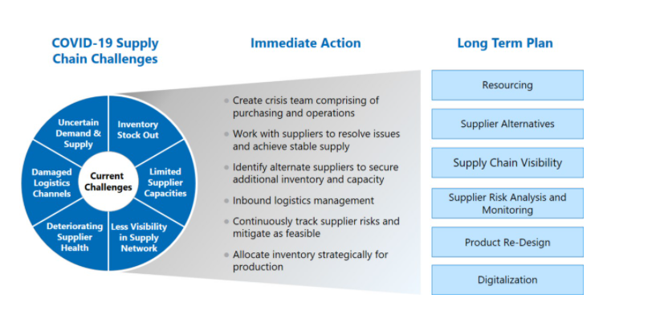
Supply Chain Diversification
Mitigating (potential) supply chain disruption…
…minimizes customer distruption!

Slide 6
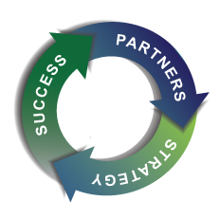
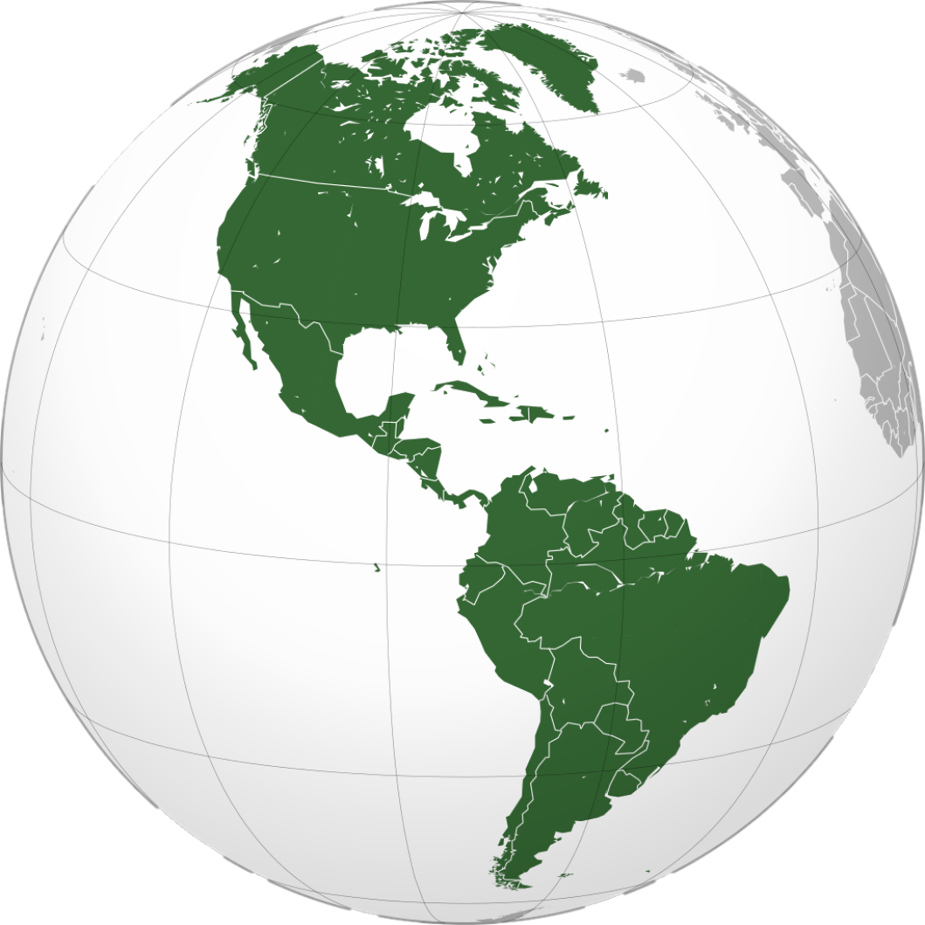
New Opportunities through Strategic Alliances
Pursue to:
Increase Market Share
Expand Market Penetration
Increase Volume

Slide 7
Communication: Customer/Employee
Customer:
Personal outreach, webinars, virtual meetings
Messaging always on brand (“business as usual”)
Consistent electronic direct mail, social media on product/people/performance
Employee:
Awareness: Mental & personal health
Flexibility: Hours, locations
Physical Health: Proactive screenings
Mental Health: Resource availability, reminders
Understanding: Individual concerns
V2-0

