Slide 1
Sector Partnership Initiative

Slide 2
What is SPI?
Connecting people, skills & Industry
NH Sector Partnerships Initiative – or NH SPI – is your company’s connection to help fill workforce gaps in New Hampshire’s construction, health care, hospitality, manufacturing and technology sectors. SPI coordinates it all at no up-front cost to your company.

Slide 3

Our Sectors

Slide 4
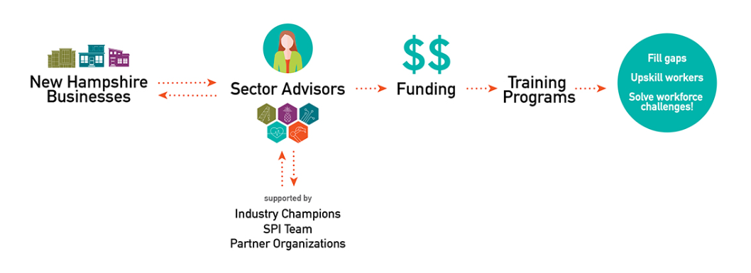
How Does SPI Work?
SPI untangles the web of workforce resources available to New Hampshire businesses.
Based on industry need and cross-industry feedback, we help connect companies with each other, and then to workforce training programs hyper-targeted to your needs now and in the future.

Slide 5

Manufacturing
Supporting 67,218 workers across approximately 1,950 businesses, manufacturing is one of New Hampshire’s largest industries.
Major economic driver for the State of New Hampshire.
Most manufacturers in this state are small-midsized, with 91.2% of manufacturers being fewer than 100 workers.
Nearly 1/3 of manufacturing workers are nearing retirement (55 or older)

Slide 6
Action Steps
The important first step is to connect with others in your sector about specific training needs and preferences.
The NH SPI team will guide you through the process, knowing when and how to pull in resources, funding, and expertise from the extensive network of partner organizations and resources.
From there, we will use your experiences and sector feedback to identify and build cross-company training programs that upskill workers based on sector needs.
If companies within these sectors can band together to identify common needs, SPI is poised to use pre-existing resources and new approaches to create training opportunities that give your current workforce the skills they’ll need to advance within your company

Slide 7
Why SPI?
Employers have hard time finding local talent
There’s a disconnect: what businesses need vs. what’s taught in schools
Things get complicated real quick (especially with government)
If you have identified needs that your current training process is unable to meet, or you need your existing team to learn a new skill, NH SPI is a valuable resource for you.
Leveraging connections with many existing workforce training programs, the NH SPI team will map your needs with state and federal funding and training resources to create a flexible, consistent plan.

Slide 8

Lets Get Started
Evania Verley
Manufacturing Sector Partnership Advisor
NH Manufacturing Extension Partnership (NH MEP)
M: 603-724-4771
E: evaniav@nhmep.org
W: www.nhmep.org

Slide 9
Let’s keep the conversation going
Joe Doiron
Director
Office of Workforce Opportunity
Joseph.A.Doiron@livefree.nh.gov
603-271-0416

