Slide 1
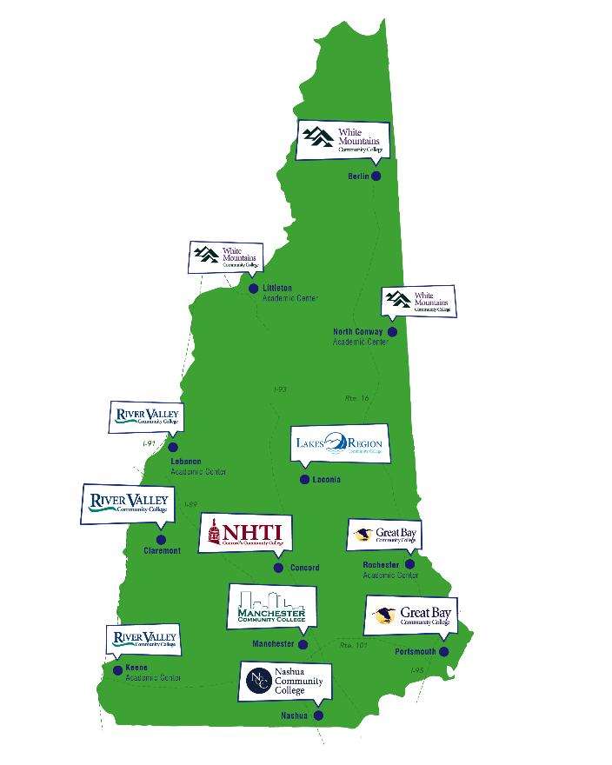
CCSNH Programs Support a Resilient and Evolving Economy
Colleges in every region of NH – local partnerships to assess/meet regional needs to serve local populations
Educational & career pathways that include:
Associate degrees & certificates
Workforce training in partnership with employers, apprenticeships & bootcamps
Strong connections to high schools/CTE including low-cost dual-credit (Running Start/Early College)
Programs designed for transfer to USNH (and others)
Programming and delivery strategies designed to meet NH’s student and business needs

Slide 2
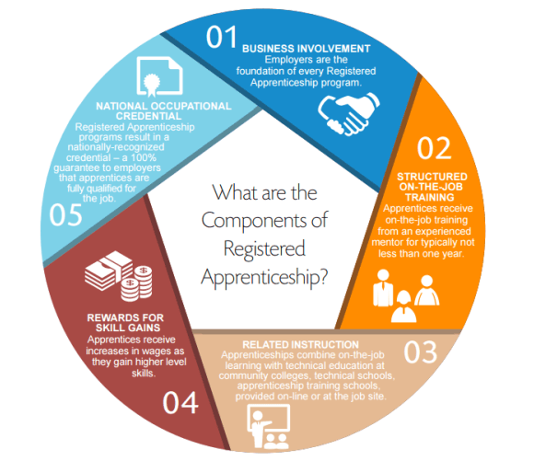
ApprenticeshipNH
Funded by grant from U.S. Department of Labor
Focus on helping employers in 5 key industries
Assist business in developing Registered Apprenticeship (RA) program
Create sustainable system for RA in NH
Connecting job seekers to apprenticeship career pathways
Notes:
Anne
Apprenticeship – 5 components, DOL Office of Apprenticeship

Slide 3
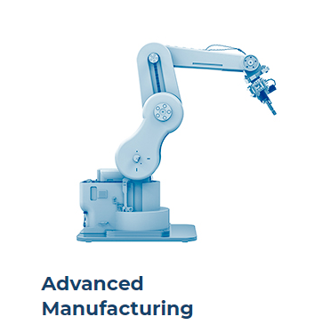
Teleflex Medical
EPTAM Plastics
Freudenberg-Nok
Safran Aerospace
Amphenol Printed Circuits
Cobham Aerospace
Wire Belt Companies of America
Granite State Manufacturing
Tecomet Inc.
Summit Packaging Systems
ARCH Medical
Stonyfield
Spraying Systems
Felton Inc
Teledyne-DGO
NH Ball Bearing

Slide 4
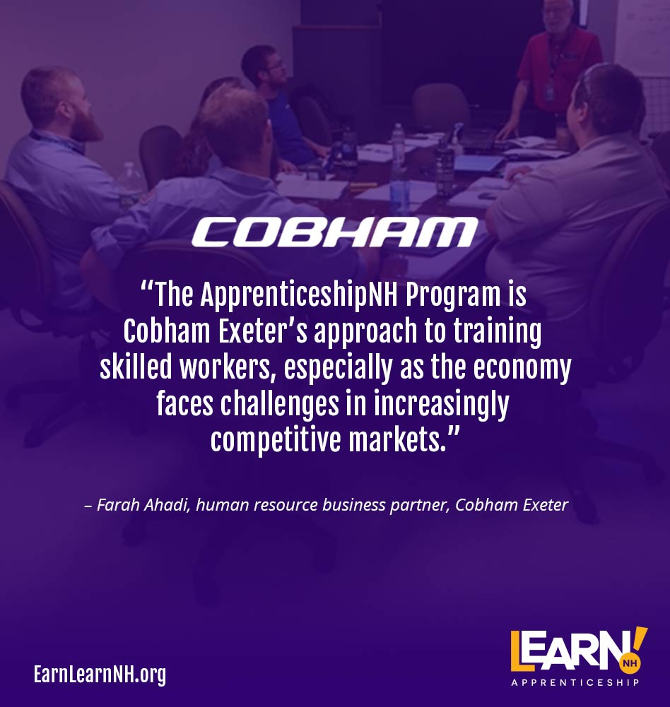
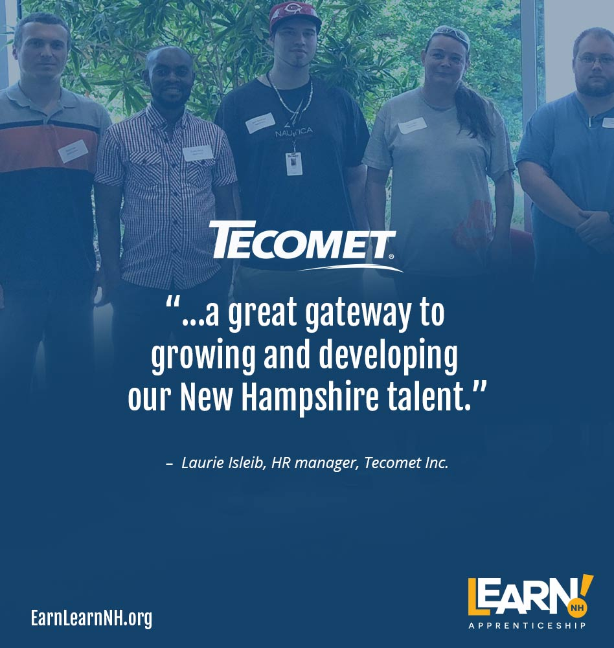
What Employers are Saying:
Notes:
Anne

