Slide 1
18th Annual Governor’s Advanced Manufacturing and High Technology Summit Workshop C: “Technology-Driven Market Intelligence”
October 29, 2020

Slide 2
Technology Driven Market Intelligence (TDMI)
RTI International
Governor's Manufacturing Summit
October 29, 2020

Slide 3
RTI is a non-profit aimed at improving the human condition.

Slide 4
We are diverse by design and connected globally.
Notes:
Our diverse global workforce makes it possible for us to deliver multidisciplinary expertise where it’s needed most. At any given time, we have ~3,000 ongoing projects with a wide range of clients in more than 50 countries.

Slide 5
We support our clients along their innovation journey.

Slide 6
We support NH MEP with growth services for technology-centered companies.
Technology-Driven Market Intelligence (TDMI)
We have something, where can we sell it?
Technology Scouting
We need something, where do we find it?

Slide 7
These services help companies grow or solve problems.
Bring New Technology or Product to Market
Path to Market
Enabling Technology
Find New Markets for Current Technology or Product
Market Opportunities
Need
Solve Operations Problems
Existing Technology

Slide 8
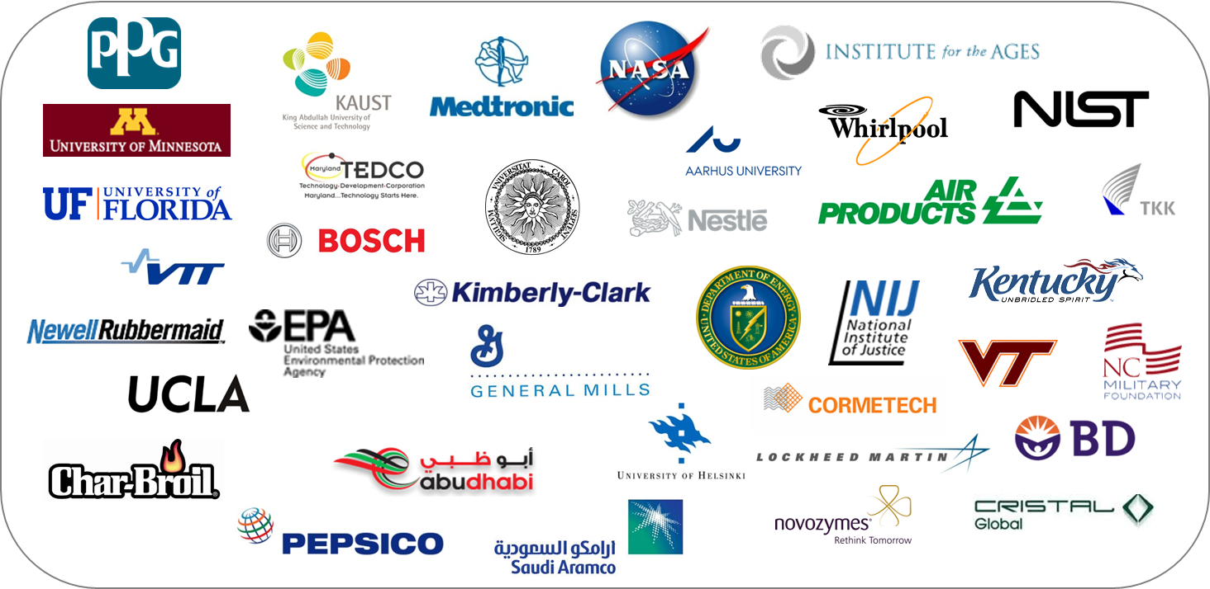
These services are used by large organizations.

Slide 9
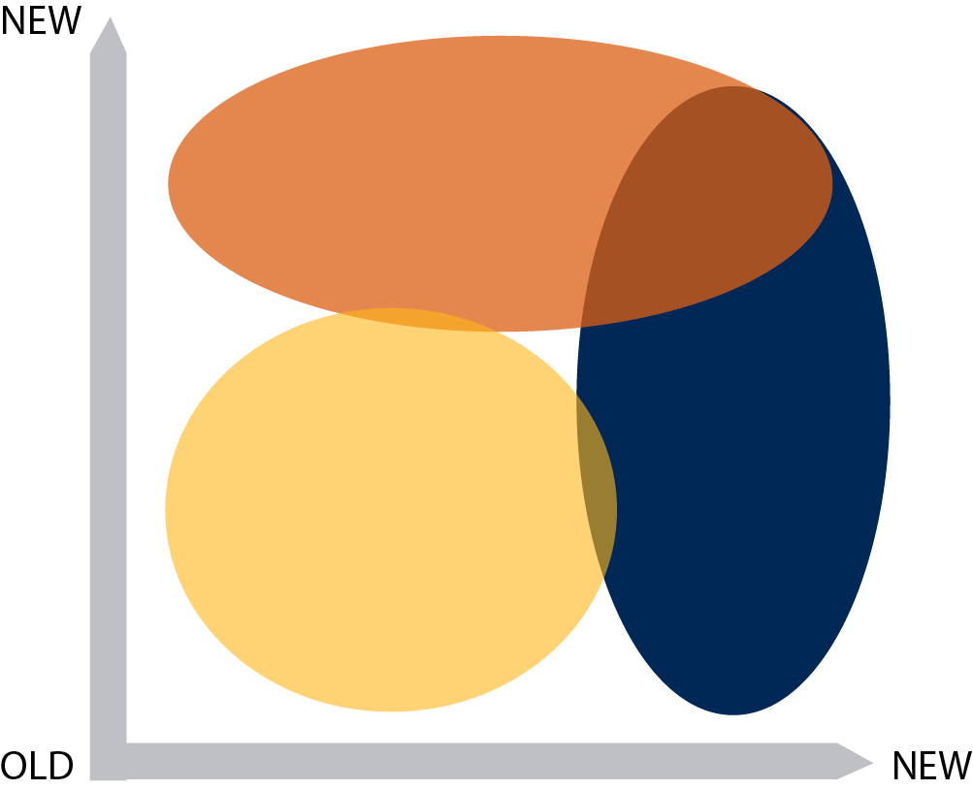
To drive innovation you have to plan for it.
TECHNOLOGY
PUSH
Functionality
DESIGN
DRIVEN
MARKET
PULL
Meaning
Page 9
Notes:
To help drive impact from R&D – the definition of innovation, we like to understand and manage the drivers of innovation. We are a fan of the model popularized by Italian Designer Roberto Verganti because of its simplicity but sophistication.
TALK TO MODEL – SPEND TIME HERE!!!!
A key thing to remember, is that people drive innovation, if we are talking
market pull, the customer is demanding next generation products and individuals in marketing are capturing the needs, designers are translating them to product concepts, engineers are making those concepts real, manufacturing is building them, then sales/distribution and the cycle comes back to the consumer.
Technology push it is about understanding emerging technologies from R&D organizations that will enable a next generation of products. The driver comes from researchers in universities, companies, federal labs creating the next generation of enabling inventions, in some cases for needs that users don’t even recognize yet.

Slide 10
These services help can help think through your grow plan.
Solve Operations Problems
Bring New Technology or Product to Market
TECHNOLOGY
PUSH
Functionality
Find New Markets for Current Technology or Product
DESIGN
DRIVEN
MARKET
PULL
Meaning
Page 10
Notes:
To help drive impact from R&D – the definition of innovation, we like to understand and manage the drivers of innovation. We are a fan of the model popularized by Italian Designer Roberto Verganti because of its simplicity but sophistication.
TALK TO MODEL – SPEND TIME HERE!!!!
A key thing to remember, is that people drive innovation, if we are talking
market pull, the customer is demanding next generation products and individuals in marketing are capturing the needs, designers are translating them to product concepts, engineers are making those concepts real, manufacturing is building them, then sales/distribution and the cycle comes back to the consumer.
Technology push it is about understanding emerging technologies from R&D organizations that will enable a next generation of products. The driver comes from researchers in universities, companies, federal labs creating the next generation of enabling inventions, in some cases for needs that users don’t even recognize yet.

Slide 11
Thinking divergently ensures a comprehensive approach.
DIVERGENT
CONVERGENT
Options
PROBLEM
SOLUTION
Find Options
Choose Options
Time

Slide 12
Technology-Driven Market Intelligence (TDMI)
We have something, where can we sell it?

Slide 13
There are many new product ideas…. how do you choose wisely?

Slide 14
TDMI helps you choose wisely but considering the “asset” and where it has value.

Slide 15
TDMI enables companies to consider…
Asset value proposition
Prudent investing options
Product and market development scenarios
Potential partners and customers
By considering technical parameters, complexities, or issues
By assessing commercial opportunities and barriers
By gathering real-world insight from industry experts
By using a proven process and robust tool set

Slide 16
Companies need TDMI when they…
Have a new idea, product, or capability
Have a current product or capability
TDMI …
Does NOT solve technical problems or identify new ideas
DOES help companies make a business decision on:
moving forward with new idea
expanding into new markets
What markets could I sell this in?
Are there other markets I can move into?

Slide 17
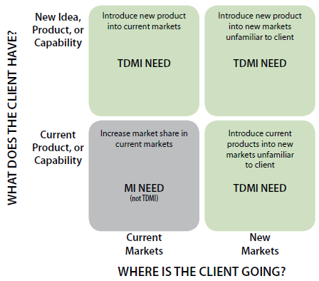
When does it make sense to use TDMI?
Technical parameters, complexities, or issues exist that need to be addressed

Slide 18
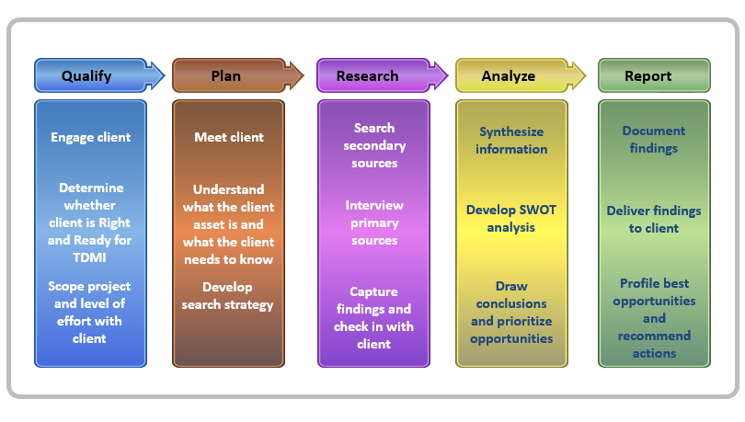
The TDMI process drives common understanding, impactful research, and actionable insights.

Slide 19
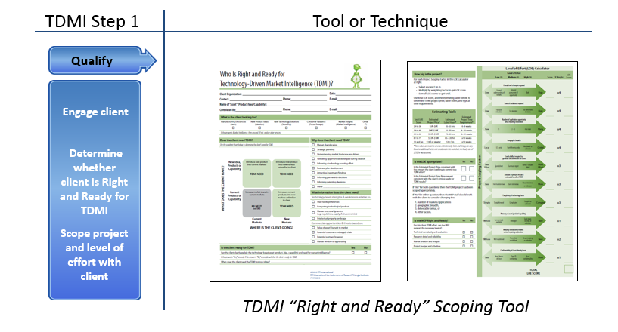
Step 1 – Qualify: scope the work

Slide 20
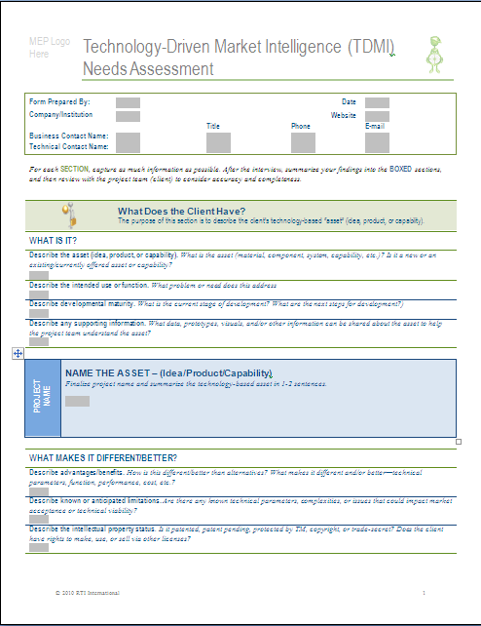
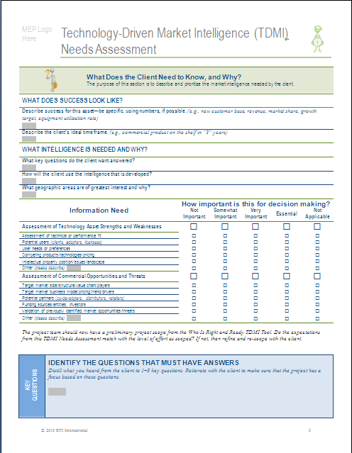
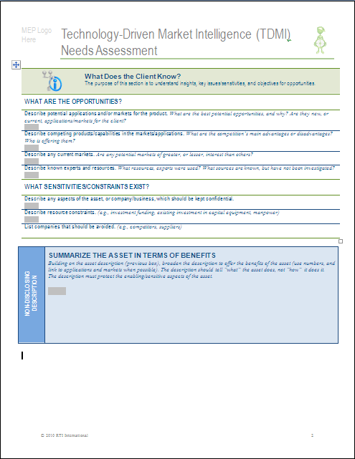
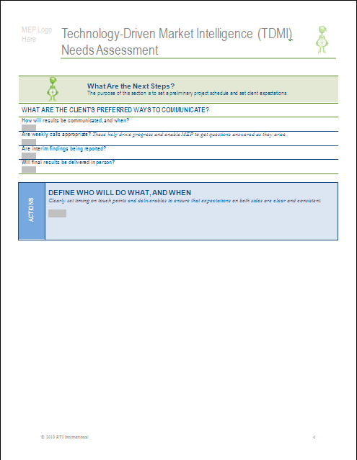
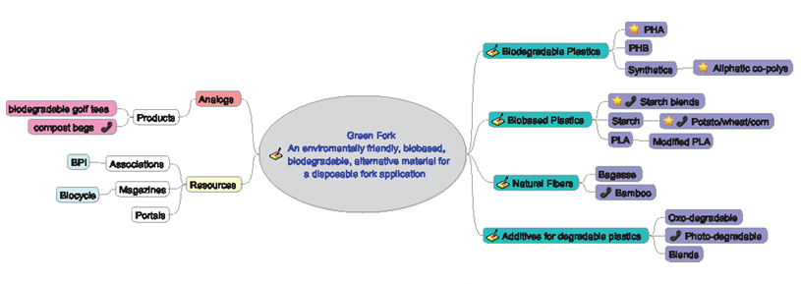
Step 2 – Plan: understand and develop a strategy
TDMI Step 2
Tool or Technique
Plan
Meet
Meet client
Understand what the client asset is and what the client needs to know
Develop search strategy
TDMI Needs Assessment Tool, Research Map

Slide 21
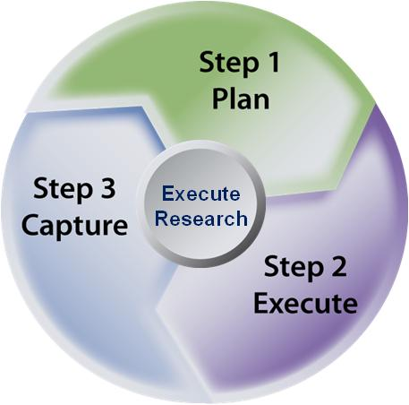
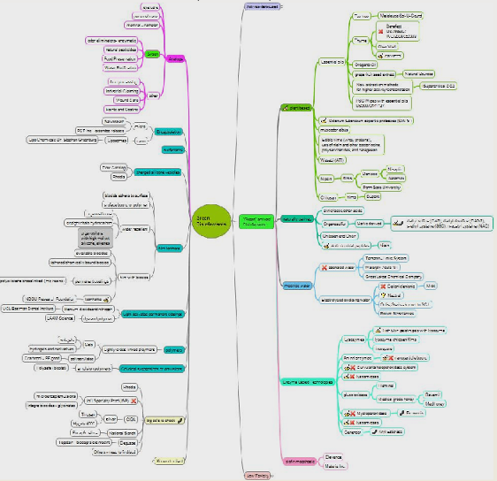
Step 3 Research: capture & manage information
TDMI Step 3
Tool or Technique
Research
Search secondary sources
Interview primary sources
Capture findings and check in with client
Standard Research Methodology
Detailed Research Map

Slide 22
Step 4 – Analyze: frameworks for opportunity priorities
TDMI Step 4
Tool or Technique
Analyze
Positive
Negative
Asset
Synthesize
information
S
W
Develop SWOT analysis
Market
O
T
Draw conclusions and prioritize
opportunities
SWOT Analysis Tool

Slide 23
Step 5 – Report: actionable recommendations

Slide 24
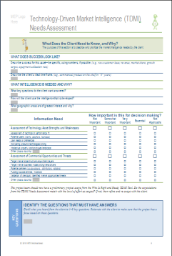
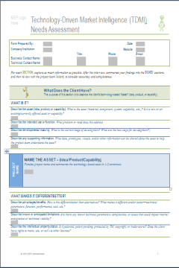
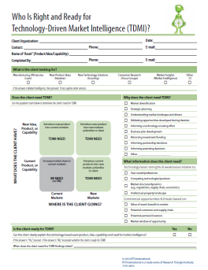
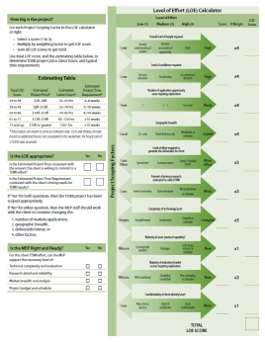
The TDMI process leverages a robust tool set.
Qualify
Plan
Research
Analyze
Report
Engage client
Meet client
Search secondary sources
Synthesize
information
Document
findings
Determine whether client is right and ready for TDMI
Understand what the client asset is and what the client needs to know
Proven Process
Interview primary sources
Develop SWOT analysis
Deliver findings to client
Scope project and level of effort with client
Develop search strategy
Capture findings and check in with client
Draw conclusions and prioritize
opportunities
Profile best opportunities
and recommend actions
Robust Tool Set
S
W
O
T

Slide 25
Questions?
Mike Osbourne
mjosbourne@rti.org
919-248-8512
Ron Poulson
ronaldp@nhmep.org
603-724-7685

Slide 27
Notes:
FINAL

Slide 28
Notes:
FINAL

